Slide 1
Elegant Galaxy Background Breakthrough
Here is where your presentation begins

Slide 2
Computational Fluid Dynamics
Mercury
Venus
Jupiter
Mercury is the closest planet from the Sun and the smallest one
It has a beautiful name and is the second planet from the Sun
Jupiter is a gas giant and the biggest planet in the Solar System

Slide 3
Launch Day Materials
Tape
Extra igniters
X-Acto knife

Slide 4
03
Clinical trial
You can enter a subtitle here if you need it

Slide 5
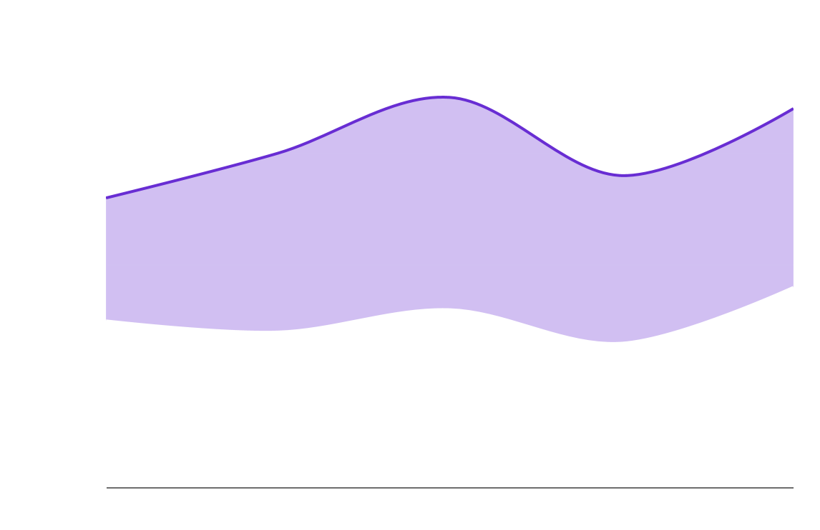
Tendency
Phase 1
Phase 2
Neptune is the farthest planet from the Sun
Saturn is a gas giant and has several rings
Follow the link in the graph to modify its data and then paste the new one here. For more info, click here

Slide 6
04
Analysis
You can enter a subtitle here if you need it

Slide 7
Results
Experiment A
Experiment B
Treatment | Test 1 | Test 2 | Test 3
Group 1 | 56 | 46 | 42
Group 2 | 45 | 64 | 23
Group 3 | 67 | 52 | 21
Treatment | Test 1 | Test 2 | Test 3
Group 1 | 33 | 25 | 56
Group 2 | 73 | 52 | 24
Group 3 | 83 | 24 | 13

Slide 8
Results analysis
Mercury
45%
It’s the closest planet to the Sun
Venus has a beautiful name
Venus
Venus has a beautiful name
20%
Mercury is quite a small planet
Mars
Mars is a very cold place
Neptune
35%
Neptune is far away from Earth
Despite being red, Mars is a cold place

Slide 9
Results analysis
60%
80%
45%
90%
Venus
Venus has a beautiful name
Earth
Earth is where we all live on
Jupiter
Jupiter is the biggest planet
Mars
Mars is actually a cold place

Slide 10
Results analysis
Jupiter
Mercury
Neptune
Mars
Jupiter is the biggest planet
Mercury is the smallest planet
Neptune is far away from the Sun
Mars is actually
a cold place
20%
30%
35%
15%

Slide 11
Success rate
75%
65%
97%
Patients cured
Within two days of treatment
Without secondary effects

Slide 12
Success rate
90%
Patients treated without side effects

